Slide 1
IMPLEMENTATION GUIDELINES
Padlet Based Peer-Assisted Learning (PAL)
A Practical Guide for Educators
Dr Adijat Omowumi Inyang (Wumi)
School of Engineering and Materials Science
Queen Mary University of London

Slide 2

PURPOSE OF THIS GUIDE
This guide will help you:
Set up Padlet for PAL activities
Facilitate structured peer learning in class
Guide students through collaborative discussion
Capture shared learning on a digital board
Outcome:
By following these steps, facilitators can run clear, structured, and engaging peer-learning sessions.

Slide 3
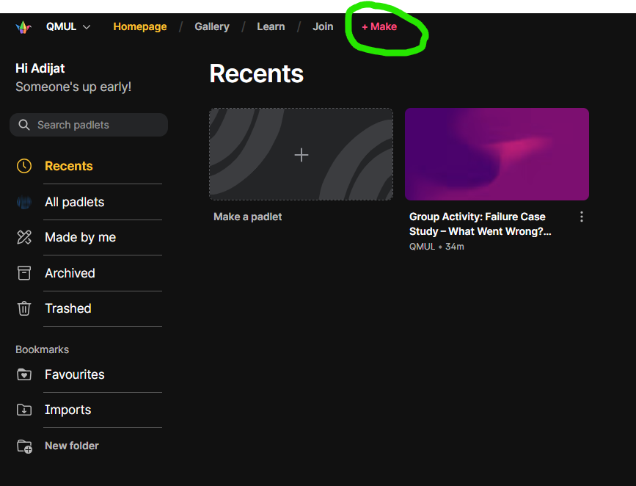

Create the padlet
Go to padlet.com here
Click Sign Up or Log In
Use your institutional email address
Click Make a Padlet

Slide 4
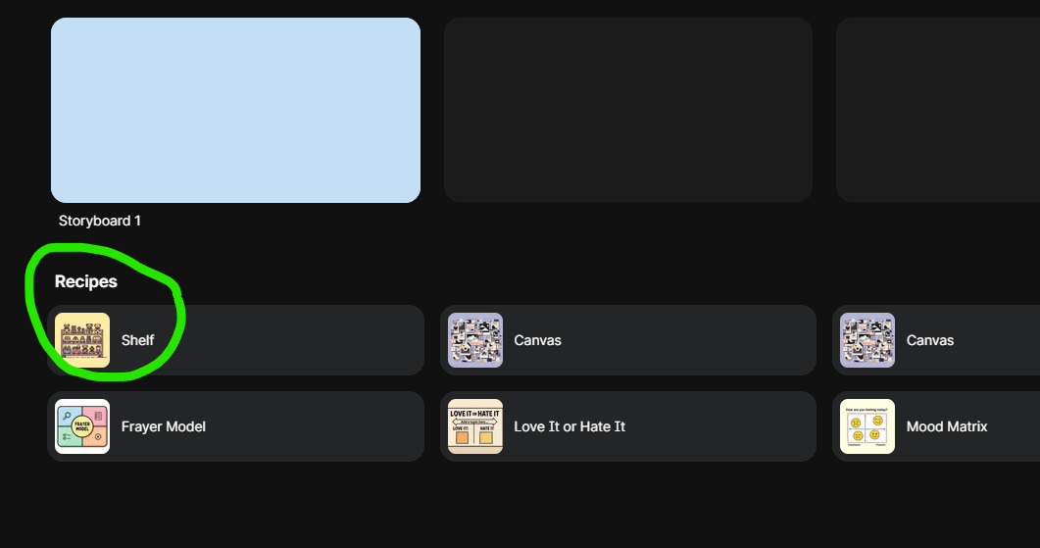
Create the padleT
When creating your Padlet, you will be asked to select a layout.
Instructions
Scroll through the available layout options
Select Shelf layout
Click Done
The Shelf layout is recommended because it works best for group-based work.

Slide 5
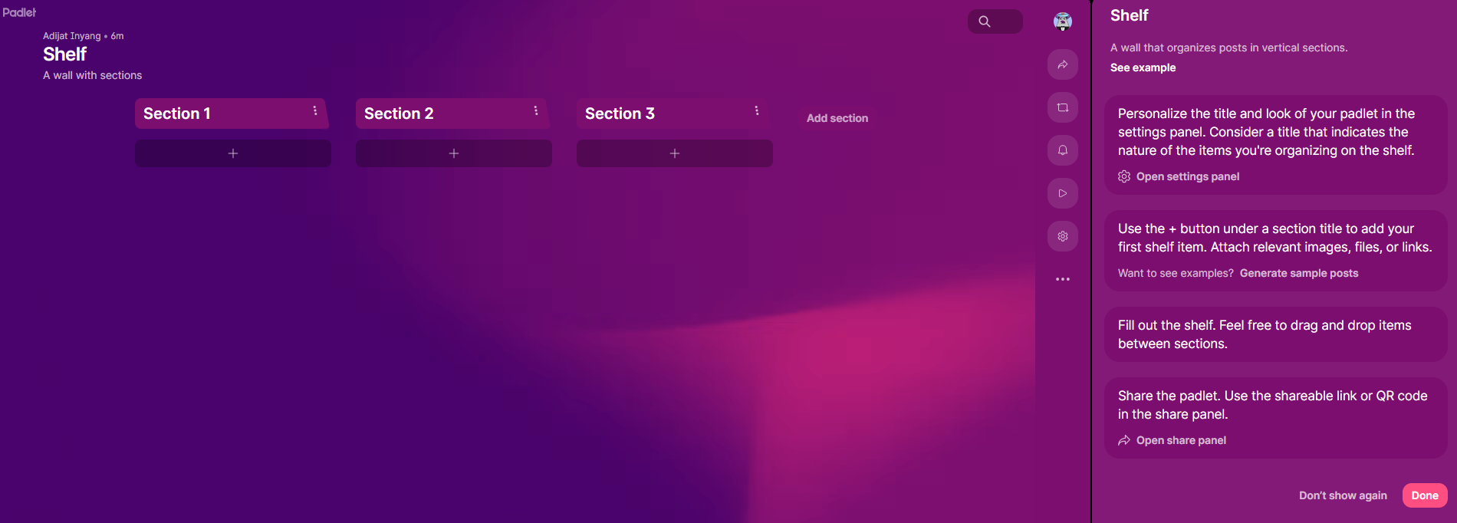
CREATE THE PADLET CONT’D
Once the Shelf layout is selected, you need to create sections (columns) for the activity.
Instructions
Click Add Section on the Padlet board
Create separate sections for each stage of the activity
Sample Section | Purpose
Warm-Up | Students share prior knowledge and questions
Group 1, Group 2, Group 3… | Each group has a dedicated space for posts
Group Summary & Comparison | Groups summarise and compare ideas

Slide 6
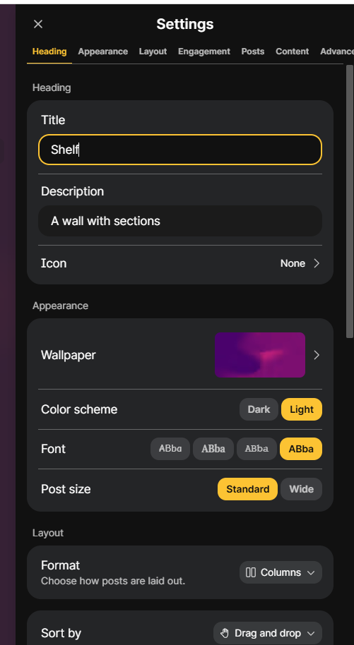
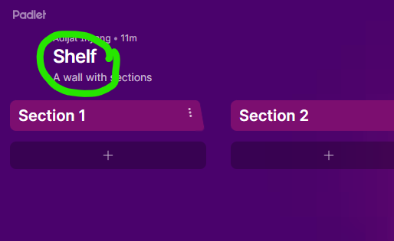
CREATE THE PADLET CONT’D
  Click Shelf to create the Padlet
  Name and Description: Add a clear title and description for the Padlet.
  You can copy and modify the example below as needed.
  Title: [Peer Learning - Group Presentations]
  Description (example)
  Each group will present [one topic / one contraceptive method / one assigned focus area].
  Use this Padlet to post:
  • Key takeaways
  • Questions
  • [clinical scenarios / examples / case discussions]
  • Group summaries
  This activity supports peer-assisted learning and [topic-specific skills e.g., contraceptive counselling skills].
  Appearance
  To keep the board clear and easy to use:
  Choose a simple background
  Keep font and colours standard

Slide 7
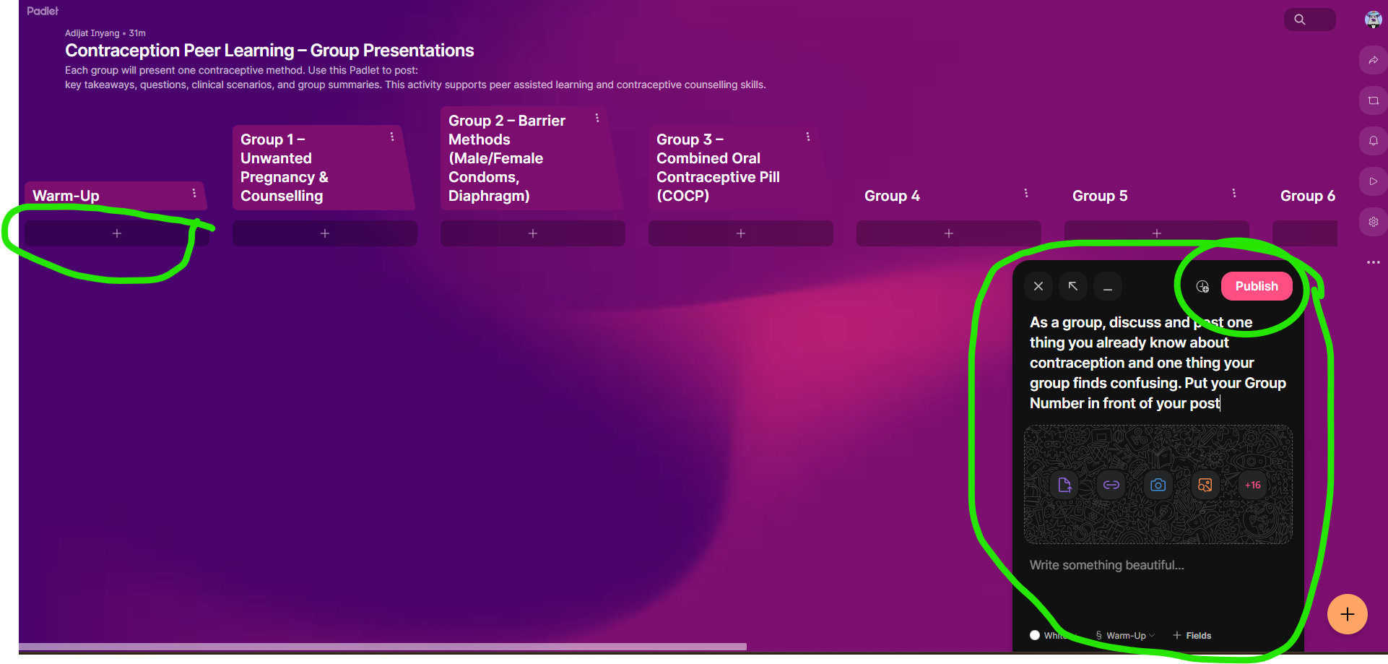
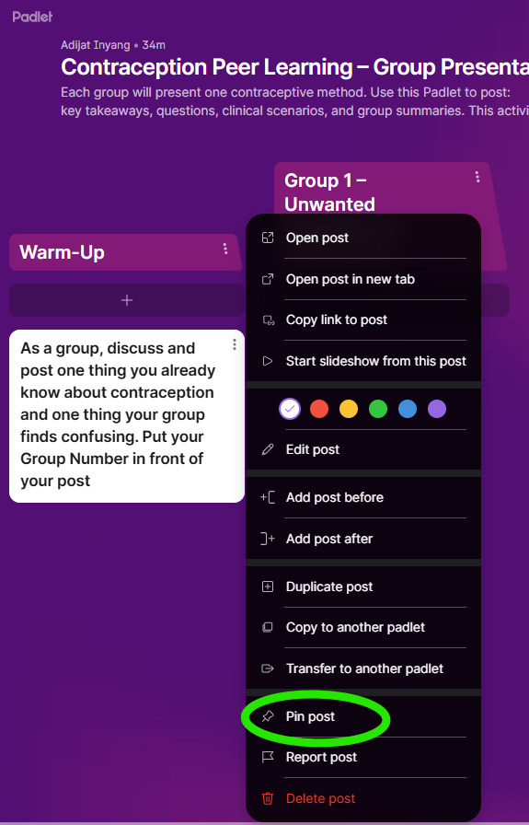
CREATE THE PADLET CONT’D
Create the first Padlet section for the Warm-Up activity.
Section Title: Warm-Up
Section Description (example)
“As a group, discuss and post:
• One thing you already know about [the topic / subject area]
• One thing your group finds confusing or unclear”

Slide 8
CREATE THE sECTIONS
1. Add a Section for Each Group
Each group needs its own section (column). Tasks can be the same or different for each group
Example Sections (customize as needed):
Group 1 – [Unwanted Pregnancy & Counselling]
Group 2 – [Barrier Methods (Male/Female Condoms, Diaphragm)]
Group 3 – [Combined Oral Contraceptive Pill (COCP)] etc
2. Add Instructions in Each Section
Include prompts for students in the section description:
“This is the space for [Group X]. During and after your presentation, other groups will post:
1 key takeaway
1 question
Peer feedback and useful resources”

Slide 9
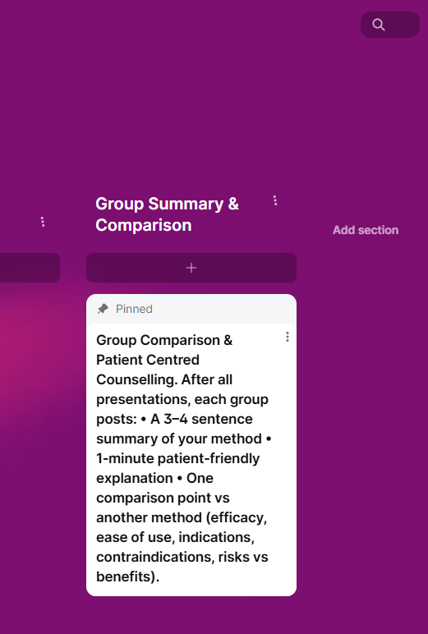
CREATE THE sECTIONS cont’d
3. Add the Final Section
Title:
Group Summary & Comparison
Description (example):
After all presentations, each group may post:
• A 3 - 4 sentence summary of their method or approach
• A 1-minute explanation suitable for a peer or beginner
This section ensures all groups consolidate and compare learning, and it serves as a revision resource. It is optional.

Slide 10
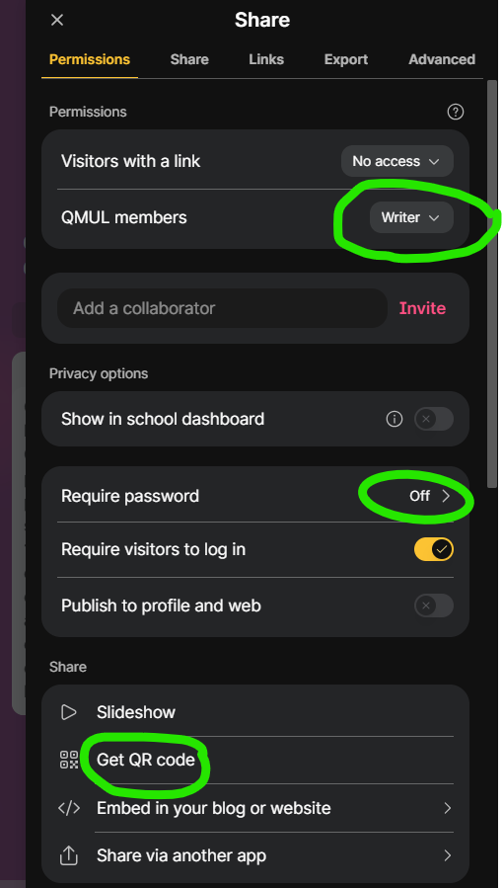
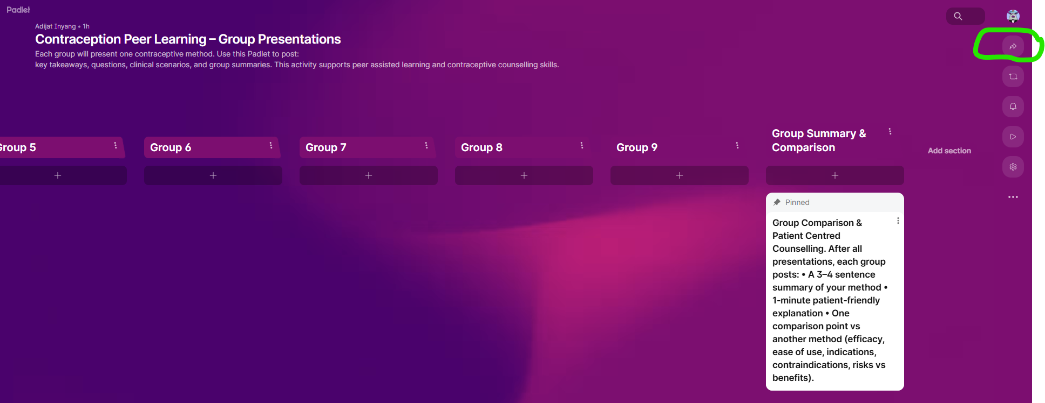
Share the Padlet and Set Permissions
Step 1: Click Share
Click the Share button at the top right of the Padlet screen
This opens the sharing and permissions menu
Step 2: Adjust Access Settings
Ensure students can participate without issues:
Allow students to write posts: [Yes / No]
Require password: [On / Off] – turn off for easier access
Require visitors to log in: [On / Off] – turn off if you want instant access
Using the QR code or link allows students to join quickly.
Step 3: Share the Padlet
Copy the link or QR code
Share via: [Email / LMS / Teams / Chat / Other platform]
Test the link or QR code before the class to ensure access works.

Slide 11
GROUP ALLOCATIONS AND FOCUS
Group Structure
Students work in small peer groups
Each group may be assigned [the same tasks / different focus areas / specific topics]
Groups are pre-allocated by the facilitator
Group focus
Each group should:
Engage collaboratively with the assigned focus area
Discuss key ideas, examples, or challenges within the group
Summarize agreed points clearly on Padlet for peer learning and comparison
Group | Topic / Focus
Group 1 | [Topic A / assigned method]
Group 2 | [Topic B / assigned method]
Group 3 | [Topic C / assigned method]

Slide 12
Basic instructions for using Padlet (for students)
Add a post
Click the “+” button at the bottom of the relevant section or column.
[Example: Warm-Up section / Group [number] section]
Title your post
Use a clear, descriptive title:
“Key takeaway – Group [number]”
or
“Summary of discussion”
Write your content
  Use short, clear points
  Focus on main ideas, not long paragraphs
Include [key points / examples / questions / discussion notes]

Slide 13
Facilitator Guide: Before Class (Setup)
1. Set up the Padlet
Ensure all sections/columns are created:
[Warm-Up], [Group 1], [Group 2], …, [Group Summary & Comparison]
Test the link and QR code to confirm access works on student devices
Optional Generic Message for Students
“You will work in small groups on a focused prompt and post your group output on Padlet. You may also be asked to share a summary with the class.”
2. Plan Group Structure
Allocate students into groups of [3 - 6 students]
Assign tasks or focus areas for each group:
[Topic / method / prompt]
Groups may self-select if appropriate
3. Brief Students in Advance
Send instructions via [email / QMplus announcement / Teams]
Explain that students will:
• Deliver a short group contribution (e.g., mini-presentation, summary)
• Collaborate on Padlet during and after the session

Slide 14
Facilitator Guide - Step 1: Warm-Up
Instructions for Students
Ask each group to add one post in the Warm-Up section of the Padlet that includes:
One thing your group already knows about [topic / focus area]
One thing your group finds unclear, challenging, or confusing
Facilitator Actions
While students post:
Scan the Padlet live for posts
Highlight recurring themes, questions, or misconceptions to the class
Use these points to guide discussion and focus for the rest of the session
Tip: This works as a prior knowledge activation or diagnostic check in any discipline.

Slide 15
Facilitator Guide - Step 2: Group Tasks with Live Padlet
Live Padlet Contributions (by other groups)
While the group is presenting:
All other groups add one group post in the presenter’s section. Each post should include:
One key takeaway (from your group’s perspective)
One question for clarification, extension, or discussion
Important: Only one post per group, not individual posts.
Group Activity
One group leads the task (e.g., [short presentation / case explanation / demonstration / discussion])
Focus on their assigned topic or focus area
Group Representative
Each group nominates one member to type and submit the post on behalf of the group
Ensures all students are engaged and encourages peer questioning
“Presentation” can be replaced with [discussion / problem-solving / scenario explanation / demonstration] depending on your discipline.

Slide 16
Facilitator Guide - Step 3: PAL discussion
After all groups have contributed to Padlet:
Each group
  Reviews posts made by other groups across the Padlet sections
  Selects:
      1–2 questions to respond to or comment on the posts
      1 scenario, example, case study, or perspective (depending on the discipline) to discuss briefly
Facilitator role
  Clarifies or corrects any inaccuracies where needed
  Highlights strong contributions and effective peer explanations
  Connects discussion points back to the intended learning outcomes
This stage consolidates learning through peer explanation, dialogue, and guided feedback.
Please note: This works well for reinforcing critical thinking, explanation, and comparison across groups.

Slide 17
Facilitator Guide - Step 4: Group Comparison & Synthesis
Instructions for Students
Direct all groups to add one post to the final synthesis section on Padlet. Each group post should include:
A 3–4 sentence summary of [their approach / method / key idea / strategy / solution / perspective]
A brief explanation of how they would explain this to [someone new to the topic / a first-year student / a non-specialist audience]
Purpose
Encourages comparison across groups
Consolidates understanding through translation and synthesis
Supports revision and post-class reference
Prompt groups to think about explaining their ideas in simple, accessible language. This section is ideal for creating a revision-ready resource.
Notes:
Visual Layout for Slide
Place the screenshot on the right side of the slide, highlighting:
The “Warm-Up” column
The post editor with instructions and Publish button
Use left side for bullet points above
Optional icons for reflection: 📝 💭 ✅
💡 Tip for facilitator:
Encourage students to focus on one key learning takeaway and share concise reflections rather than long paragraphs.

Slide 18
Facilitator Guide - Step 4: Group Comparison & Synthesis
Student Reflection (5–10 min, in class or post-class)
Ask students to complete a short reflection individually or in groups:
One thing they understand better as a result of peer discussion
One question or area they want to explore further
One skill developed during the activity (e.g., explaining ideas, questioning, collaboration)
[Specify platform: Padlet / MS Forms / LMS / Written submission]
Follow-Up Activities (Optional)
Revisit selected Padlet posts in the next class to address common questions
Ask students to refine or expand posts after feedback
Use Padlet contributions as a study or revision resource
Link to Assessment (Optional)
Clarify how this activity supports:
Formative learning
Preparation for summative assessment
Where relevant, specify whether Padlet engagement contributes to:
[Participation marks]
[Reflective writing]
[Group coursework or presentations]

Slide 19
Facilitator Guide - Step 5: Reflection, Follow-Up, and Assessment
Student Reflection (5–10 min, in class or post-class)
Ask students to complete a short reflection individually or in groups:
One thing they understand better as a result of peer discussion
One question or area they want to explore further
One skill developed during the activity (e.g., explaining ideas, questioning, collaboration)
[Specify platform: Padlet / MS Forms / LMS / Written submission]
Follow-Up Activities (Optional)
Revisit selected Padlet posts in the next class to address common questions
Ask students to refine or expand posts after feedback
Use Padlet contributions as a study or revision resource
Link to Assessment (Optional)
Clarify how this activity supports:
Formative learning
Preparation for summative assessment
Where relevant, specify whether Padlet engagement contributes to:
[Participation marks]
[Reflective writing]
[Group coursework or presentations]

Slide 20
Facilitator Guide - Step 5: Reflection, Follow-Up, and Assessment
Student Reflection (5–10 min, in class or post-class)
Ask students to complete a short reflection individually or in groups:
One thing they understand better as a result of peer discussion
One question or area they want to explore further
One skill developed during the activity (e.g., explaining ideas, questioning, collaboration)
[Specify platform: Padlet / MS Forms / LMS / Written submission]
Follow-Up Activities (Optional)
Revisit selected Padlet posts in the next class to address common questions
Ask students to refine or expand posts after feedback
Use Padlet contributions as a study or revision resource
Link to Assessment (Optional)
Clarify how this activity supports:
Formative learning
Preparation for summative assessment
Where relevant, specify whether Padlet engagement contributes to:
[Participation marks]
[Reflective writing]
[Group coursework or presentations]

Slide 21
Facilitator Guide - Facilitator-Led Synthesis & Discussion
Step: Highlight and Discuss Padlet Posts
Select a few student posts on the Padlet to read aloud or highlight.
Use the posts to prompt whole-class discussion and compare ideas across groups.
Suggested Discussion Prompts
Facilitator can adapt based on the discipline:
Which approaches, methods, strategies, models, tools, interventions, theories, or solutions appear most effective and why?
Which options are easiest to use, apply, or implement in practice?
What limitations, risks, or constraints should be considered?
In which contexts do additional benefits or wider impacts matter most?
In time-critical or high-stakes situations, which option would you choose and why?
Facilitator Actions
Guide discussion using evidence and reasoning
Clarify misconceptions where needed
Encourage students to justify choices and compare perspectives
Tips for Adaptation
Prompts can be tailored to focus on:
[Effectiveness / efficiency]
[Usability / applicability]
[Ethics / risks]
[Accessibility / context-specific considerations]

Slide 22
Facilitator Guide – AFTER CLASS
Preserve the Padlet
  Export the Padlet or keep it accessible as a shared revision and reference resource.
  Signpost students to revisit it when preparing for assessments or further study.
Provide brief follow-up feedback (optional)
  Share a short feedback note with the cohort or groups highlighting:
      Common strengths observed
      Common misconceptions or areas for improvement
      Examples of effective peer contributions
This helps close the feedback loop and reinforces learning beyond the live session.
Please note: Feedback can be delivered via email, QMplus announcement, or short in-class recap.

Slide 23
Facilitator Guide – AFTER CLASS
Instructions for Students
You will work in groups for this activity. There are no individual marks for Padlet contributions unless stated otherwise.
As a group, you are expected to:
Prepare a short group contribution on your assigned topic, approach, or focus area
(e.g., [presentation / explanation / case summary / demonstration / other task])
Contribute posts to Padlet during other groups’ contributions by:
Identifying [one key takeaway / main idea]
Posing [one question for discussion / clarification]
Create a final group summary and comparison synthesizing your approach with those of other groups
(Include [3–4 sentence summary / simple explanation for beginners])
Purpose
This activity supports:
Shared learning
Comparison of ideas
Peer discussion

Slide 24
Student GUIDANCE (GROUP-BASED) CONT’D
How your group uses Padlet
Padlet will be used as a shared group workspace throughout the session. All posts should be made on behalf of your group, not individually.
Warm-up (start of session)
As a group, add one post in the Warm-Up section that includes:
One thing your group already knows about the topic
One thing your group finds unclear or confusing
During other groups’ contributions
For each group, your group should add one post in that group’s section with:
One key takeaway from their contribution
One question for clarification, extension, or discussion
(One group member can type the post on behalf of
the group.)
After your own contribution
Once your group has completed your tasks:
Review the posts in your group’s section
Decide together:
  Which 1–2 questions to respond to
  Which example, scenario, or point to discuss briefly with the class
Final synthesis
In the final synthesis section, your group should post:
A 3 - 4 sentence summary of your approach, idea, or method
A brief explanation of how you would explain this in simple, accessible language
Tips for success
Focus on clarity rather than length
Agree on key points before posting
Use Padlet posts to support discussion, not just to record notes

Slide 25
STUDENT GUIDANCE (GROUP-BASED)
Expectations
Work collaboratively
Everyone in the group should contribute to discussions, decisions, and Padlet posts.
Use appropriate, evidence-informed sources
Base your contributions on reliable and relevant information for the context of the task.
Be respectful and constructive
Ask questions and discuss scenarios in a professional, supportive, and inclusive way.
These expectations help create a positive learning environment where all students can participate and learn from each other.

Slide 26
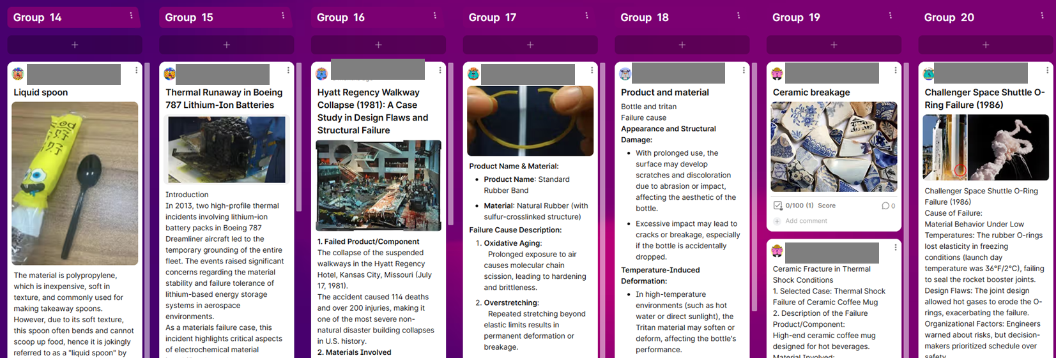
Screenshot of a completed Padlet PAL task

